Slide 1
Policies for climate change mitigation: state of the art of energy efficiency in Italy
IPA Study Tour – Turkey
Memo, 28 April 2016

Slide 2
Framework and objectives
The European Climate-Energy Packages
 | 2020 | 2030
Reduction of green-house gas emissions (compared with levels of 1990) | 20% | 40%
Increase of renewable energy share (% on final consumption) | 20% | 27%
Increase of energy efficiency (% compared with "trend" consumptions) | 20% | 27%

Slide 3
Italian strategic Documents on environment/ energy
Main documents are:
National Energy Strategy (SEN Ministerial Decree of 8 marzo 2013)
Green policies are placed in a broader energy perspective and lines of action are set in the medium term (detailed scenario until 2020)
7 priorities of action are set to improve gas and electricity markets, infrastructures and prices
CO2 Reduction Plan (approved by the Interministerial Committee for Economic Planning- CIPE on March 2013)
Indicates a complete set of measures to be used for decarbonization.
It is a document to be matched with the SEN
Next: National Plan for Climate and Energy (within the European Strategy for the ”Energy Union”)
Forecast until 2030
Initial contributions and projections at the end of 2016

Slide 4
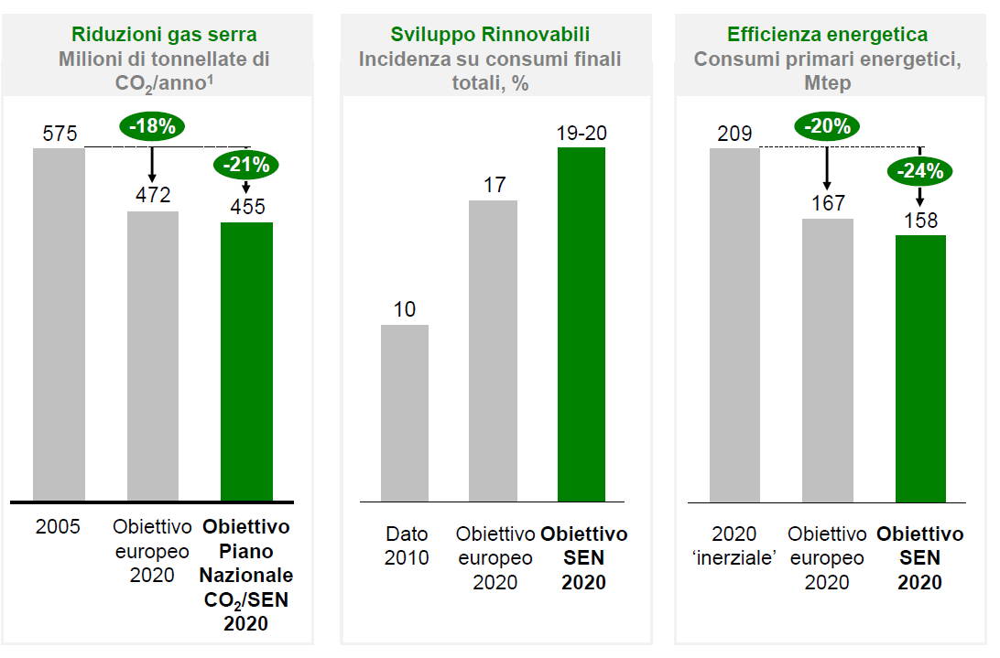
Track indicated by the SEN until 2020

Slide 5
What happened until now?
In the last years, the bigger effort of green policies, at least from a financial perspective, has been focused on electric production from renewable energy sources.
Two simple data summarize facts: at present, electric final consumption from RES is at around 35%, far beyond 26% that we recently aimed to reach by 2020!
In financial terms, also following the strong expansion of photovoltaic energy, the total value of the national incentives for electric renewable energies reached a cost of around 12.5 billion Euros per year.

Slide 6
What about outside electric sector?
Far less explosive has been the growth of the two other green instruments necessary to focus on targets: thermal renewable sources and energy efficiency.
On energy efficiency, the National Energy Strategy underlines the “potential to exploit”: by 2020 we can reach energy savings for around 15 MTep compared to trend projection of energy consumptions. We are moving in such direction but we need to speed up.

Slide 7
What action? The Italian distibution of energy consumtion indicates that it is necessary to effectively cover all sectors
Main sectors | % on total final energy consumtion (in 2010)
Residential | 23
Services | 13
Industry | 26
Trasports | 32
Other | 6
Source: Ministry of Economic Development/SEN

Slide 8
Strategic documents on energy efficiency
Energy efficiency potentials and policy tools are described in details in three main documents, developed by the National Agency for New Technologies, Energy and Sustainable Development (ENEA):
PAEE (Plan of Action for Energy Efficiency) referred to all sectors
STREPIN (Strategy to Requalify National Buildings)
PANZEB (National Plan of Action to Increase Near Zero Energy Buildings)

Slide 9
Focus on buildings Main data:
In Italy there are 14 million buildings. More than 60% of them was built before 1976 (year referring to the first legislation on energy efficiency – Law n. 373/1976)
90% consist of residential buildings.
10% consist of buildings of other use (PA, officies, commercial, services) of which:
n. 51.000 schools with a total surface of 73 million square meters;
n. 3.000 buildings owned by the Central Government with a total surface of 14 million square meters.

Slide 10
Focus on buildings. Main tools:
1. Higher standards and more tight legislation
2. Fiscal benefits
3. New incentives for the Public Administation (PA):
3/a. Heating and Cooling Support Scheme (Conto Termico)
3/b. Programme for Requalifing Buildings owned by the Central Government
3/c. Kyoto Fund

Slide 11
1. Legislative standards
New energy requirements have been established for buildings (Law Decree n. 63/2013 and Ministerial Decree of 26 giugno 2015)
In particular, from 1 january 2021 all newly constructed buildings shall be identified as “Near Zero Energy Buildings” (NZEB): such target has been anticipated to 31 December 2018 for new buildings occupied and/or owned by Public Administations
Projections:
Need to stenghten support and incentive measures for construction of NZEB
Application of Minimum Environmental Criteria (MEC) in public procurement (mandatory with the Law 50/2016-Codice appalti)
MEC for sostenability in buildings (materials, water consumption, indoor air quality..)

Slide 12
2. Fiscal benefits
Fiscal benefits for interventions of energy efficiency have been disciplined by the Italian Financial Law for 2007. Basically, a share of the the investments in energy efficiency is detracted from personal income tax for individuals or on business income tax for companies (tax credit is currently 65%).
Main interventions covered by such tax benefits are the following:
Improvements in existing building envelopes (thermal insulation of walls, roofs and floors, windows, installation of solar screens);
Replacement of existing systems for winter heating with more efficient ones (condensing boilers);
Installation of solar panels for hot water production.
Fiscal benefits are considered successful: on an annual basis they push over 3 billion Euros investments.
Prospects:
Need to differentiate fiscal benefits in order to promote best interventions in terms of energy savings considering full technical life-cycle of interventions.

Slide 13
3/a. Incentivies for the PA: Heating and Cooling Support Scheme (Conto Termico)
The Heating and Cooling Support Scheme supports, besides renewable sources, interventions of energy efficiency for buildings owned by the PA.
Practically, such support scheme covers the same interventions interested by the fiscal benefits for private buildings (condensing boilers, windows, thermal insulation) .
Such incentive consists of non-repayable contributions which cover a share of the investment depending on the kind of intervention adopted.
The total expenditure for inteventions regarding energy efficiency of buindings owned by the PA can reach a maximum of 200 million Euros per year.
Prospects:
The Heating and Cooling Support Sheme has been recently revised with the introduction of simplified access to such incentive for the PA (for instance, the possibility of "booking" the incentive and increased contribution up to 65%)

Slide 14
3/b. Incentives for the PA: the Programme for Requalifing Buildings owned by the Central Government (CG)
EU Directive n. 27/2012 on energy efficiency establishes that each year, until 2020, 3% of the surface covered by buildings owned by the CG shall be restructured. The total surface to be requalified amounts to 2,5 million square meters.
Energy requalification is carried out following a "Programme of interventions" yearly defined based on requests brought by interested PAs.
In 2014-2015 have been presented projects for interventions for an amount of around 70 million Euros. The Italian Ministry of Environment contributes with 21,5 million Euros (deriving from CO2 auctions of the EU-ETS System).
Prospects:
In order to start interventions, an interministerial decree identifing criteria and modalities for the implementation of the Programme needs to be finalized.

Slide 15
3/c. Incentives for the PA: Kyoto Rotating Fund for Schools
The Kyoto Fund finances energy requalification of schools with loans at a preferential rate of 0,25%.
We have already launched a first tender (June – September 2015).
103 million Euros requested.
n.190 applications for interventions of energy requalification.
n.400 applications for energy audits.
A second tender is currently running (open since April 2016) .
247 million Euros available.

