Slide 1
World Bank Group Vendors
MAy, 2016

Slide 2
Overview
The World Bank Group Vendors
What do we procure?
How to do business with the WBG?
Getting started – econsultant2
More information

Slide 3
The World Bank Group Vendors
The World Bank Group (WBG) procures goods and services to meet the needs of the World Bank Group following the principles of fairness, transparency, competition and overall best value.
The WBG is committed to creating an environment that fosters open, global and transparent competition for the goods and services used by the Bank Group in its worldwide operations.
We take great care in the selection of our Vendors. Before any contract/purchase order is issued or payment made, it is mandatory for Vendors to register with the WBG, meet the WBG’s Vendor Registration and Vendor Eligibility Guidelines and be reviewed against possible financial, conflict of interest and/or contractual risk considerations.

Slide 4
What do we procure ?
The WBG procures a wide variety of goods and services including, but not limited to:
Information Technology
Communications Equipment and Services
Professional & Technical Consulting Services
Office Supplies, Paper & Paper Products
Graphic Design, Publications & Print Services
Construction & Renovation
Facilities Management Services & Equipment
And Other Administrative Services

Slide 5
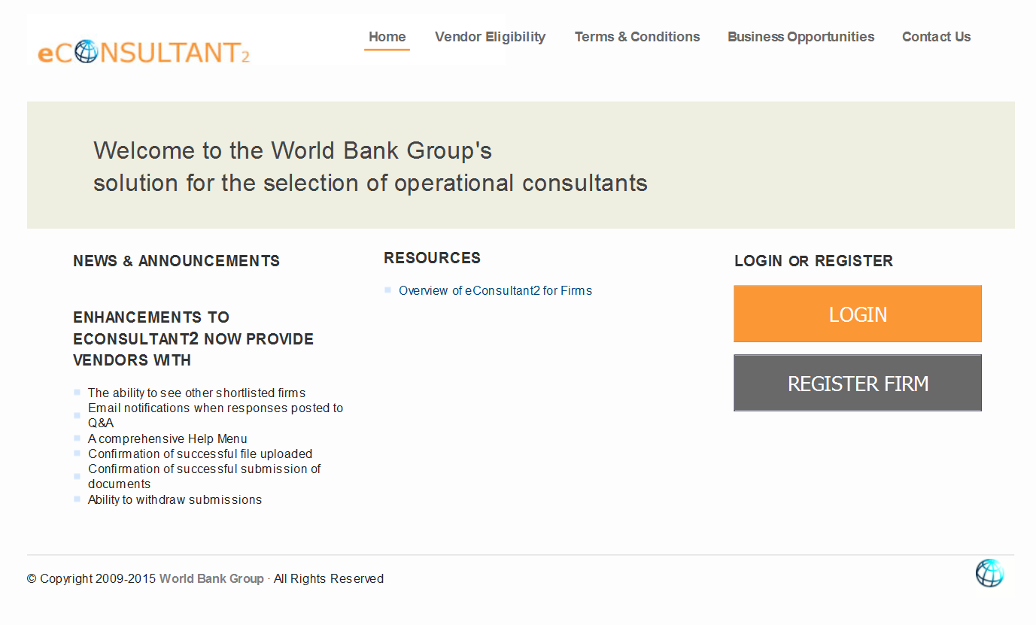
How to do business with the WBG ?
The WBG promotes open competition through its procurement process. Purchases made by the Bank Group follow a formal competitive bidding process whenever possible. Bank Group solicitations (Professional and technical consultancies) are advertised on “econsultant2”; the WBG solution for the selection of operational consultants.

Slide 6
How to do business with the WBG ?
The Bank Group’s terms and conditions are posted on the econsultant2 (ec2). It is the vendor’s responsibility to review the terms and conditions prior to bidding, accepting an order, rendering services or shipping goods to the WBG.
Vendors do not need to be registered to participate in the Bank Group solicitation process, however, in order to receive a contract award they must be “Approved”, which requires completion of a Vendor Registration form, meeting all eligibility requirements and providing all required documentation. Completion of a Vendor Registration application, however, does not guarantee that a vendor will be approved. Once a vendor is approved it is added to the WBG Vendor Master File.
Only responsible vendors are eligible to receive WBG contracts. Vendors found to be non-responsible may be excluded from future contract awards.

Slide 7
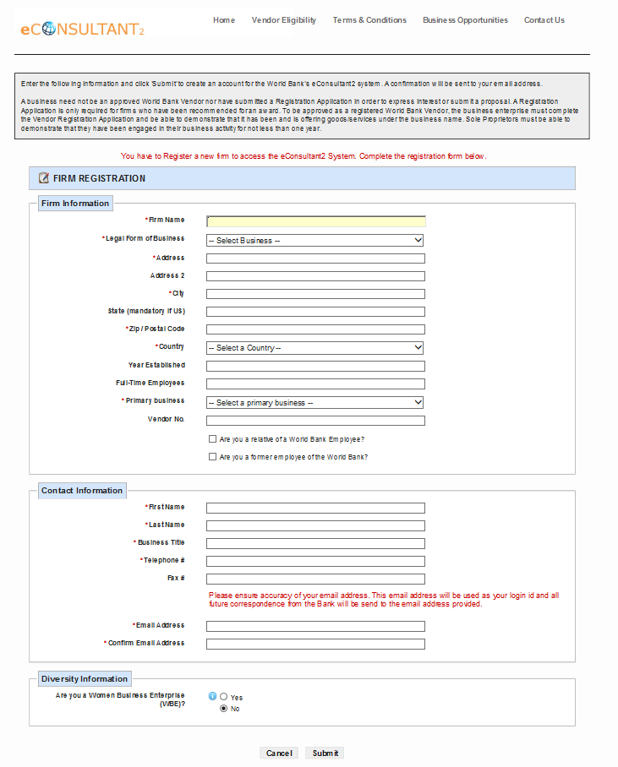
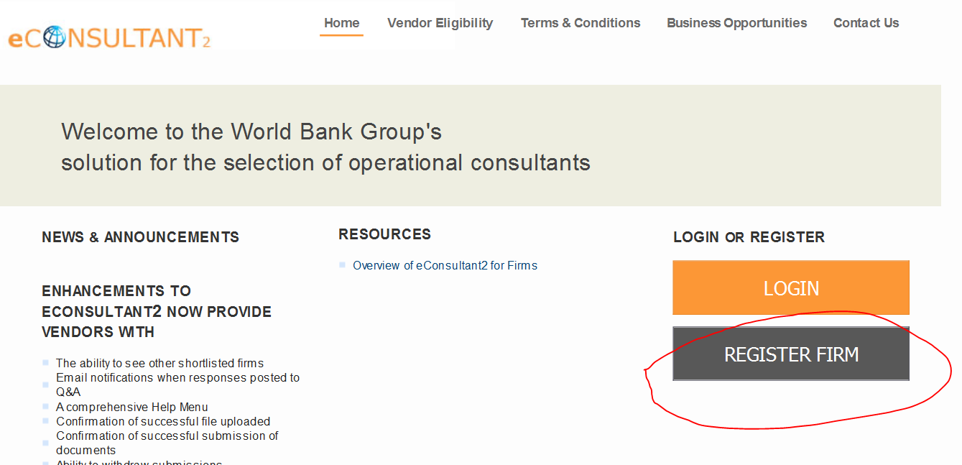
Getting started – ec2
To get started, click register new firm:
Then fill the form and submit. You will get
an e-mail with a new temporary password.

Slide 8
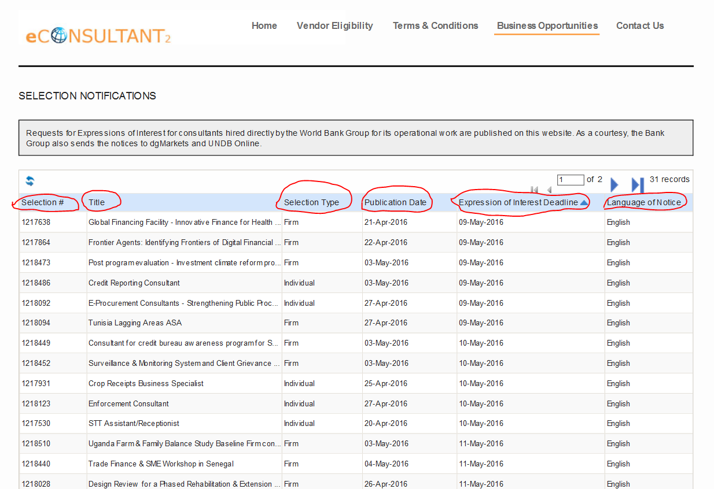
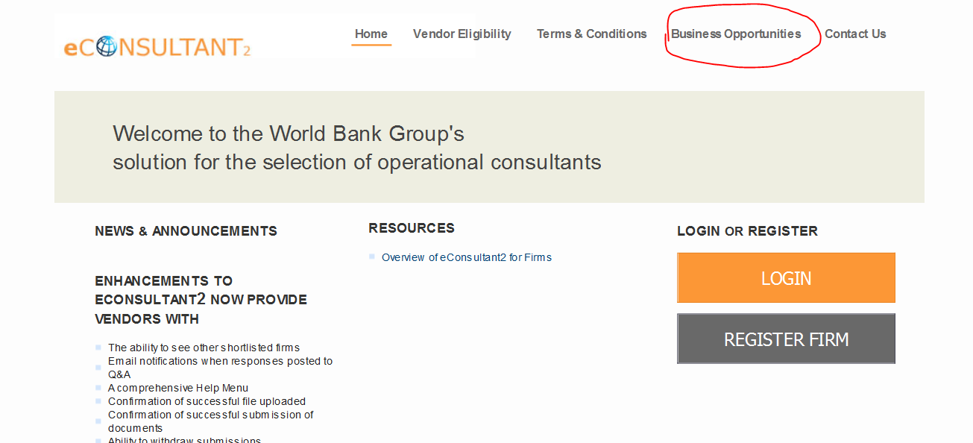
Getting started – ec2
All publicly advertised opportunities show here:
You can sort by any column by clicking the heading.
*** You do not have to be logged in to view advertisements

Slide 9
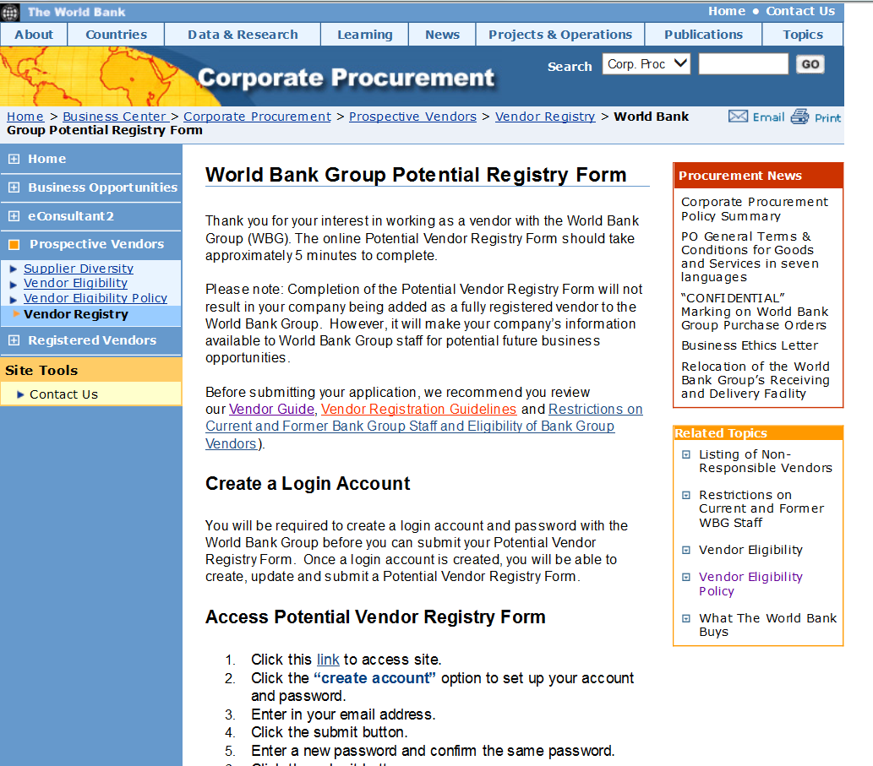
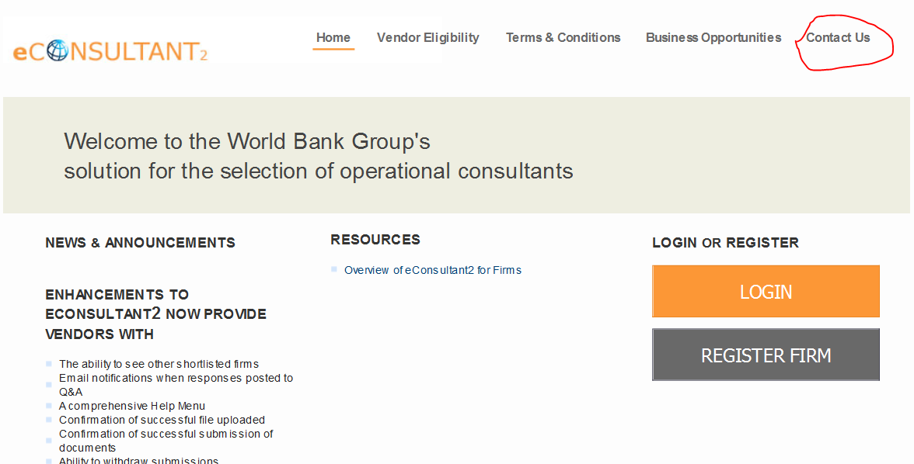
More information
For more information:
Please visit: http://web.worldbank.org/WBSITE/EXTERNAL/OPPORTUNITIES/EXTCORPPROCUREMENT/0,,contentMDK:20207522~menuPK:7092655~pagePK:64147231~piPK:64147158~theSitePK:438017,00.html
Or access ec2 and contact us!

